Slide 1


Meet the AI!
Demystifying AI & Algorithms

Slide 2

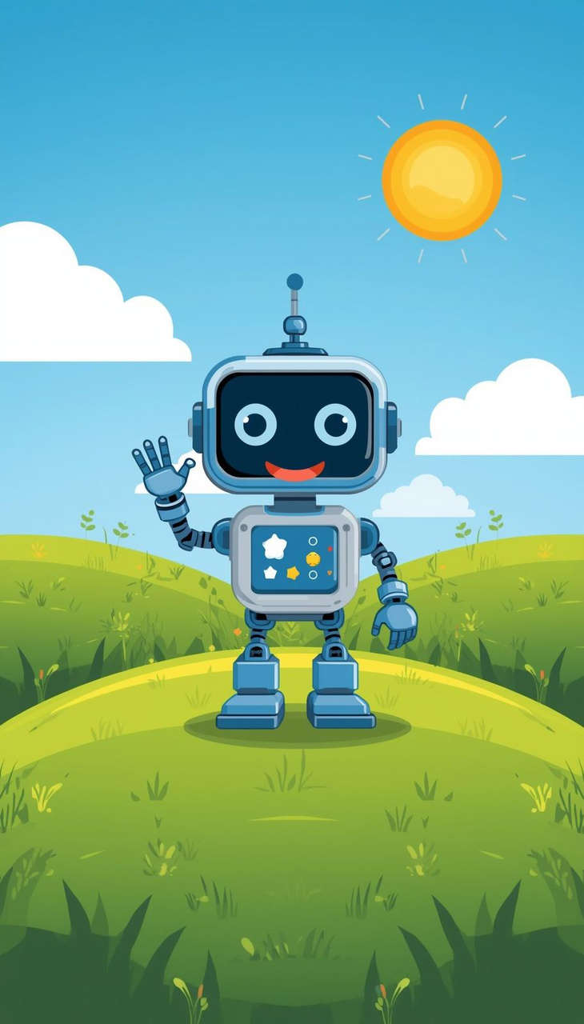


What is Artificial Intelligence?
Let's Find Out Together! Get ready for an amazing adventure into the world of AI!

Slide 3






Three Big Ideas About AI
What AI Sees
What AI Learns
What AI Does
AI uses cameras and sensors to look at pictures, words, and sounds - just like your eyes and ears!
AI learns from lots of examples, like how you learn to recognize animals by seeing many cats and dogs!
AI helps us solve problems and make things easier, like suggesting fun videos or helping cars drive safely!

Slide 4
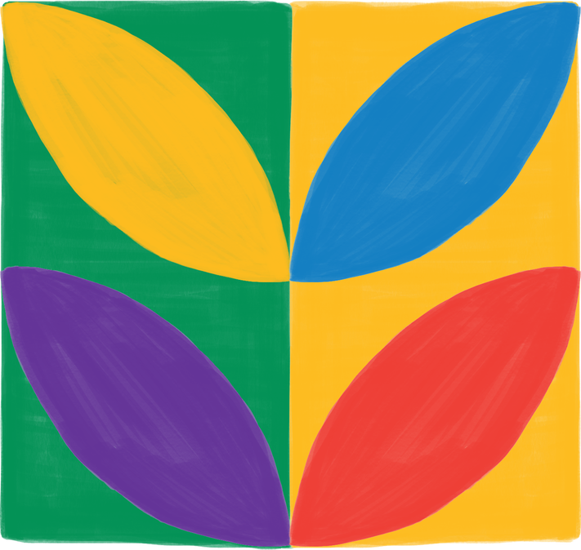
AI All Around Us!
Voice Assistants
Video Games
"Hey Siri!" or "OK Google!" - these helpers use AI to understand what you say and answer your questions!
AI makes game characters smarter! It helps them chase, hide, and play against you like real opponents.
Recommendations
Smart Toys
When YouTube or Netflix suggests videos you might like, that's AI learning what makes you smile!
Some toys can talk back, learn your name, and even play games with you - all thanks to AI!

Slide 5
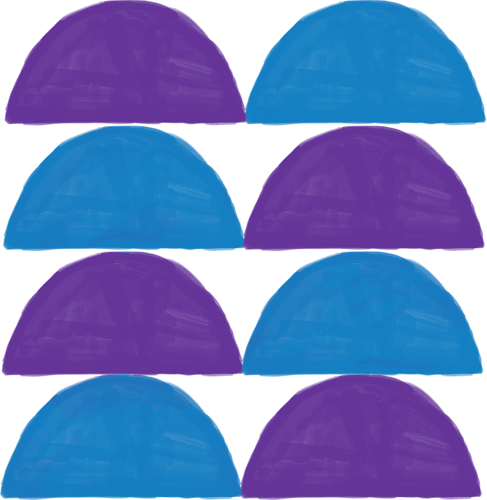
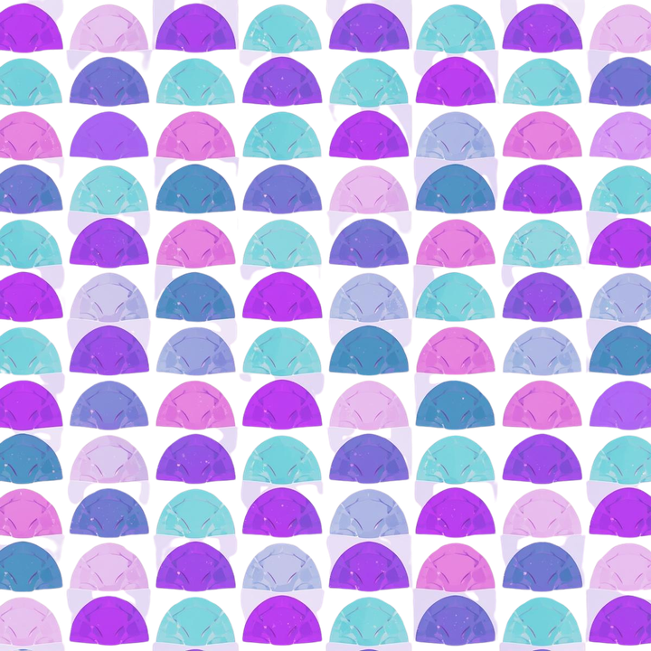
What's an Algorithm?
It's Like a Recipe!
An algorithm is step-by-step instructions that computers follow, just like how you follow a recipe to bake cookies!
Computers Need Directions
Without algorithms, computers wouldn't know what to do! They help computers solve problems one step at a time.

Slide 6

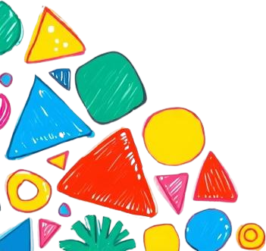
Algorithms in Action!
Making a Sandwich
First bread, then peanut butter, then jelly, then more bread - that's an algorithm!
Getting Dressed
Underwear first, then pants, then shirt, then shoes - you follow steps in order!
Playing a Game
Roll the dice, move your piece, follow the rules - games have algorithms too!

Slide 7
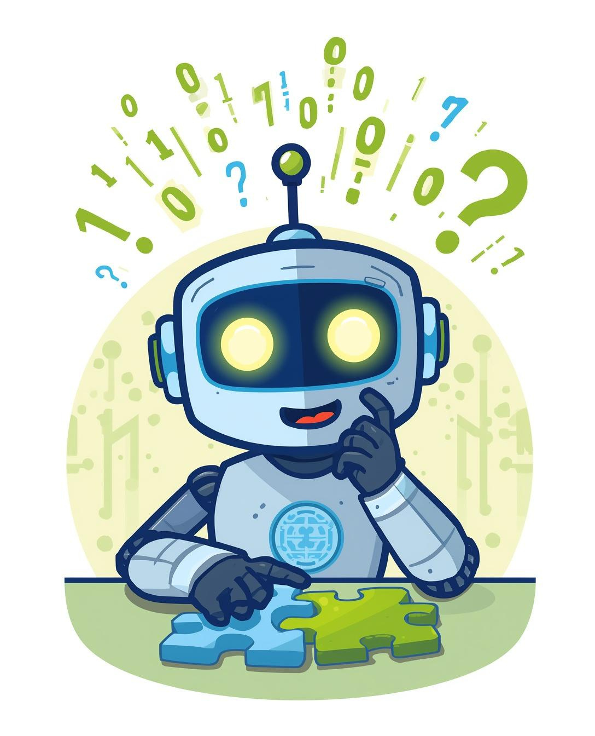

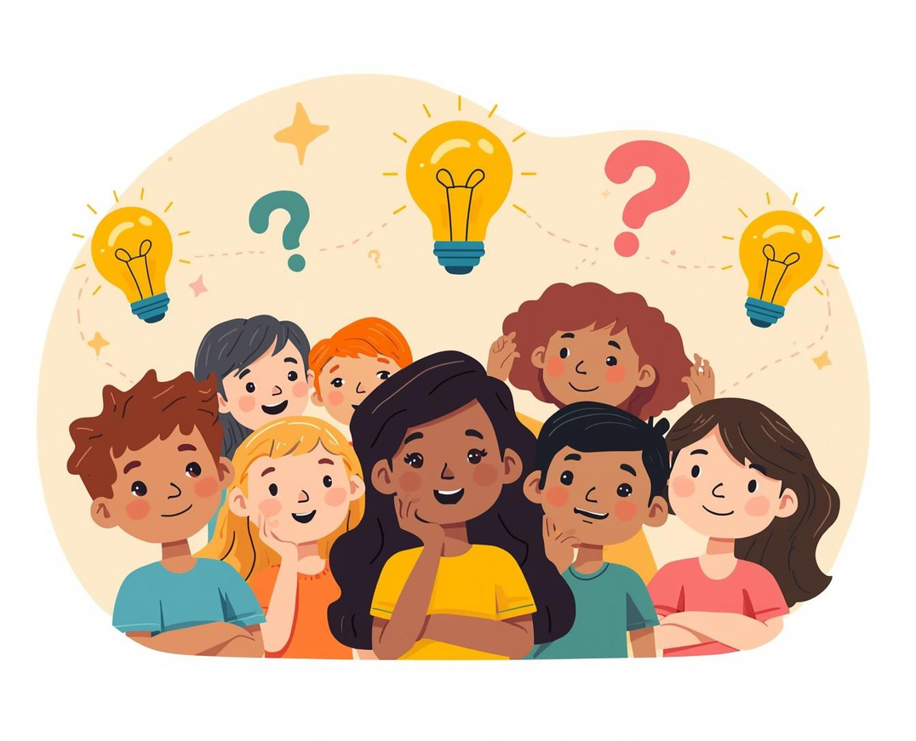

Human vs AI: How We Both Learn and Solve Problems

Slide 8

Cool Things to Know About AI!
AI Needs Lots of Practice!
Just like learning to ride a bike or play a game, AI has to try things over and over to get better!
AI Learns From Examples!
AI learns by looking at tons of examples - just like how you learn new words by reading lots of books!

Slide 9

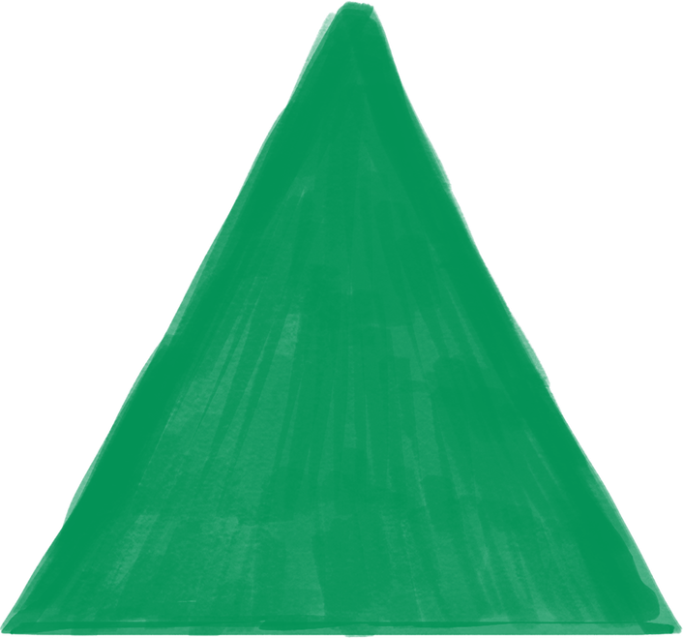
You're Now an AI Explorer! See You Next Time!
Great job today! You learned so much about AI and algorithms!

